Slide 1
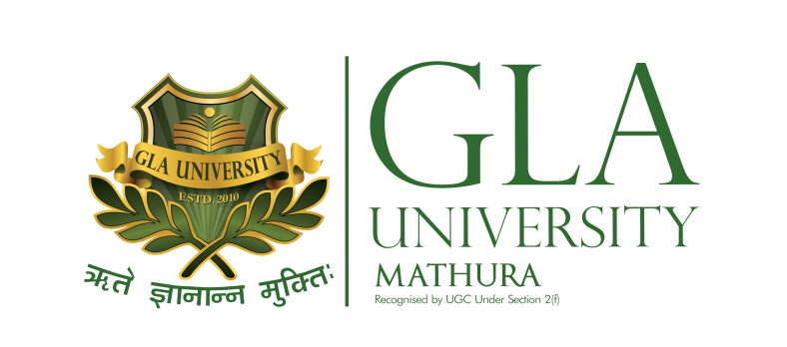
DATABASE MANAGEMENT SYSTEM BCSC0003
By
Suman Kumar Bhattacharyya
Assistant Professor
Computer Engineering and Application Department

Slide 2
Course Objective
Introduction to basics of DBMS
Familiarize with a tool
Emphasis on Design stages of Databases
Guide through Different design stages
Gain understanding of fundamental concepts of state-of-the art databases (more precisely called: Database Management Systems)
Know enough so that it is possible to read/skim a database system manual and
Experiment and practice with industry leading vendor solutions:

Slide 3
Why Database Management System
Database Management System is a technology of storing and retrieving data with utmost efficiency along with appropriate security measures.
Traditionally, data was organized in file formats.
DBMS was a new concept to overcome the deficiencies in traditional style of data management.

Slide 4
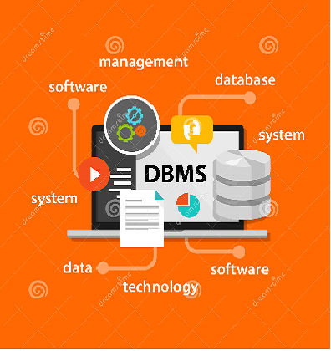
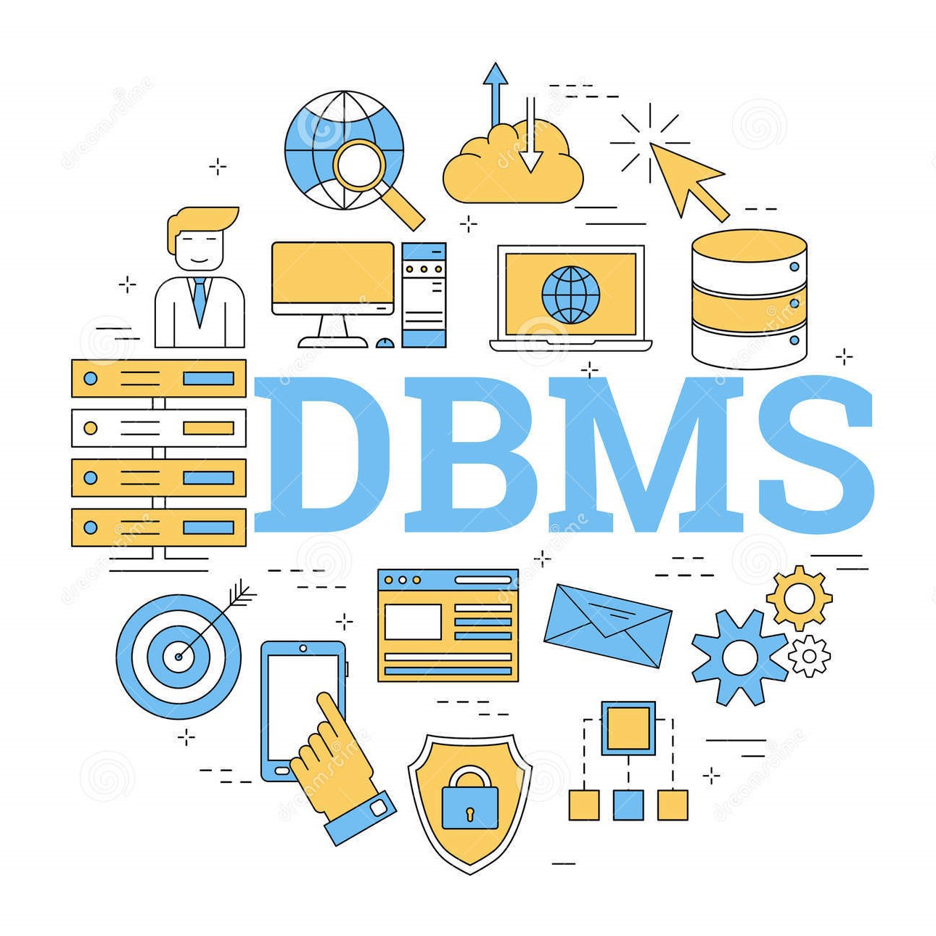
Why Database Management System

Slide 5
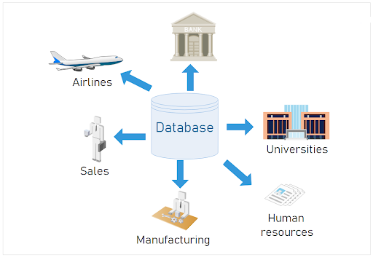
Why Database Management System

Slide 6
Applications of Database Management System
Railway Reservation System
Library Management System
Banking
Universities and colleges
Credit card transactions
Social Media Sites

Slide 7
Applications of Database Management System
Telecommunications
Finance
Online Shopping
Human Resource Management
Manufacturing
Airline Reservation system

Slide 8
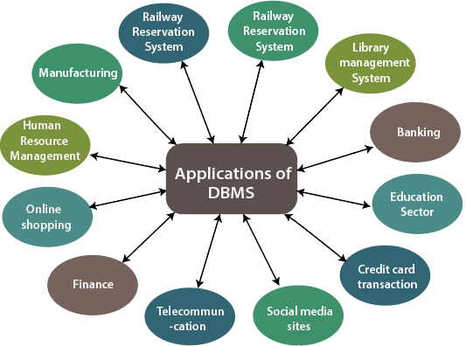
Applications of Database Management System

Slide 9
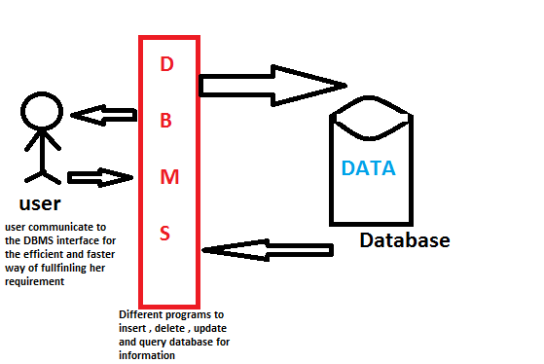
Database Management System- Overview

Slide 10
Database Management System- Overview
Database is a collection of related data and data is a collection of facts and figures.
Mostly data represents recordable facts.
Data aids in producing information, which is based on facts.
For example, if we have data about marks obtained by all students, we can then conclude about toppers and average marks.
A database management system stores data in such a way that it becomes easier to retrieve, manipulate, and produce information.

Slide 11
Database System vs File System
File system is basically a way of arranging the files in a storage medium like hard disk.
File system organizes the files and helps in retrieval of files when they are required.
File systems consists of different files which are grouped into directories.
The directories further contain other folders and files.
File system performs basic operations like management, file naming, giving access rules etc.
Example,
NTFS(New Technology File System), EXT(Extended File System)

Slide 12
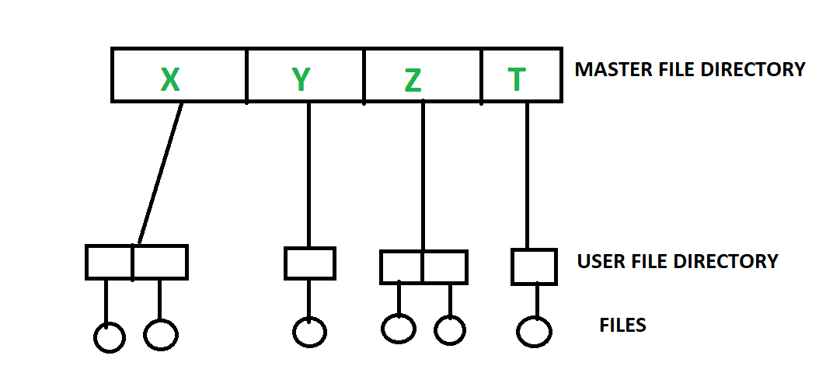
File System

Slide 13
Database System vs File System
Database Management System is basically a software that manages the collection of related data.
It is used for storing data and retrieving the data effectively when it is needed.
It also provides proper security measures for protecting the data from unauthorized access.
In Database Management System the data can be fetched by SQL queries and relational algebra.
It also provides mechanisms for data recovery and data backup.
Example,
Oracle, MySQL, MS SQL server

Slide 14
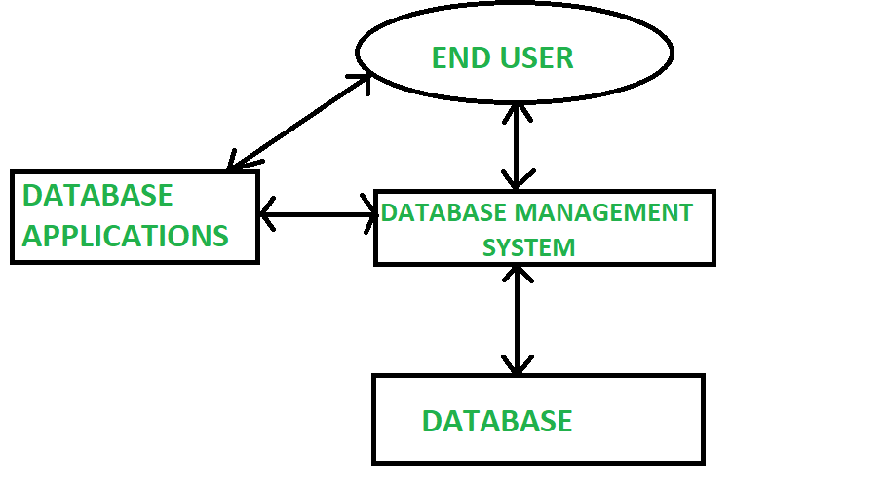
Database System

Slide 15
Database System vs File System
Sl No. | File System | Database System
1 | File system is a software that manages and organizes the files in a storage medium. | DBMS is a software for managing the database.
2 | Redundant data can be present in a file system. | In DBMS there is no redundant data.
3 | It doesn’t provide backup and recovery of data if it is lost. | It provides backup and recovery of data even if it is lost.
4 | There is no efficient query processing in file system. | Efficient query processing is there in DBMS.
5 | There is less data consistency in file system. | There is more data consistency because of the process of normalization.
6 | It is less complex as compared to DBMS. | It has more complexity in handling as compared to file system.
7 | File systems provide less security in comparison to DBMS. | DBMS has more security mechanisms as compared to file system.

Slide 16
Advantages of DBMS
Data redundancy
Redundancy is the concept of repetition of data i.e. each data may have more than a single copy.
The file system cannot control redundancy of data as each user defines and maintains the needed files for a specific application to run.
There may be a possibility that two users are maintaining same files data for different applications.
Hence changes made by one user does not reflect in files used by second users, which leads to inconsistency of data.
Whereas DBMS controls redundancy by maintaining a single repository of data that is defined once and is accessed by many users. As there is no or less redundancy, data remains consistent.

Slide 17
Advantages of DBMS
Data sharing
File system does not allow sharing of data or sharing is too complex.
Whereas in DBMS, data can be shared easily due to centralized system.
Data concurrency
Concurrent access to data means more than one user is accessing the same data at the same time. Anomalies occur when changes made by one user gets lost because of changes made by other user.
File system does not provide any procedure to stop anomalies. Whereas DBMS provides a locking system to stop anomalies to occur.

Slide 18
Advantages of DBMS
Data searching
For every search operation performed on file system, a different application program has to be written.
While DBMS provides inbuilt searching operations. User only have to write a small query to retrieve data from database.
Data integrity
There may be cases when some constraints need to be applied on the data before inserting it in database. The file system does not provide any procedure to check these constraints automatically.
Whereas DBMS maintains data integrity by enforcing user defined constraints on data by itself.

Slide 19
Advantages of DBMS
System crashing
In some cases, systems might have crashes due to various reasons. It is a bane in case of file systems because once the system crashes, there will be no recovery of the data that’s been lost.
A DBMS will have the recovery manager which retrieves the data making it another advantage over file systems.
Data security
A file system provides a password mechanism to protect the database but how longer can the password be protected? No one can guarantee that.
This doesn’t happen in the case of DBMS. DBMS has specialized features that help provide shielding to its data.

Slide 20
Today we have discussed the followings,
An Overview of Database Management System
Database System vs File System and
Database System Concept.

Slide 21

Thanks

